Slide 1

ECEN 361
Real-Time and Embedded Systems
Lecture 11 – FreeRtos (cont)

Slide 2
Outline
Quick review of real-time systems
Overview of RTOSes
Goals of an RTOS
Features you might want in an RTOS
Learning by example: FreeRTOS
Introduction
Tasks
Interrupts
Internals (briefly)
What’s missing?

Slide 3
FreeRTOS Features
Source code
Portable
Romable
Scalable
Preemptive and co-operative scheduling
Multitasking
Services
Interrupt management
Advanced features

Slide 4
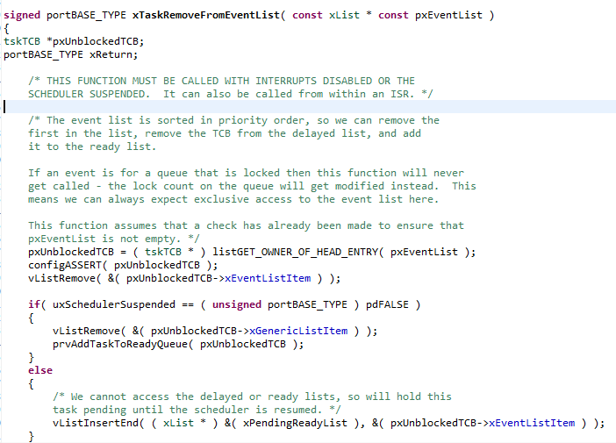
Source Code
High quality
Neat
Consistent
Organized
Commented

Slide 5





Portable
Highly portable C
24 architectures supported
Assembly is kept minimum.
Ports are freely available in source code.
Other contributions do exist.

Slide 6

Scalable
Only use the services you only need.
FreeRTOSConfig.h
Minimum footprint = 4 KB
Version in lab is 24 KB including the application (which is fairly large) and data for the OS and application.
Pretty darn small for what you get.
~6000 lines of code (including a lot of comments, maybe half that without?)

Slide 7
Preemptive and Cooperative Scheduling
Preemptive scheduling:
Fully preemptive
Always runs the highest priority task that is ready to run
Comparable with other preemptive kernels
Used in conjunction with tasks
Cooperative scheduling:
Context switch occurs if:
A task/co-routine blocks
Or a task/co-routine yields the CPU
Used in conjunction with tasks/co-routines

Slide 8
Multitasking
No software restriction on:
# of tasks that can be created
# of priorities that can be used
Priority assignment
More than one task can be assigned the same priority.
RR with time slice = 1 RTOS tick

Slide 9
Services
Queues
Semaphores
Binary and counting
Mutexes
With priority inheritance
Support recursion

Slide 10
Interrupts
An interrupt can suspend a task execution.
Interrupt mechanism is port dependent.

Slide 11
Advanced Features
Execution tracing
Run time statistics collection
Memory management
Memory protection support
Stack overflow protection

Slide 12
Device support in related products
Connect Suite from High Integrity Systems
TCP/IP stack
USB stack
Host and device
File systems
DOS compatible FAT

Slide 13
Licensing
Modified GPL
Only FreeRTOS is GPL.
Independent modules that communicate with FreeRTOS through APIs can be anything else.
FreeRTOS can’t be used in any comparisons without the authors’ permission.

Slide 14
A bit more
System runs on “ticks”
Every tick the kernel runs and figures out what to do next.
Interrupts have a different mechanism
Basically hardware timer is set to generate regular interrupts and calls the scheduler.
This means the OS eats one of the timers—you can’t easily share.
OK, onto tasks!

Slide 15
Outline
Quick review of real-time systems
Overview of RTOSes
Goals of an RTOS
Features you might want in an RTOS
Learning by example: FreeRTOS
Introduction
Tasks
Interrupts
Internals (briefly)
What’s missing?

Slide 16
Tasks
Each task is a function that must not return
So it’s in an infinite loop (just like you’d expect in an embedded system really, think Arduino).
You inform the scheduler of
The task’s resource needs (stack space, priority)
Any arguments the tasks needs
All tasks here must be of void return type and take a single void* as an argument.
You cast the pointer as needed to get the argument.
I’d have preferred var_args, but this makes the common case (one argument) easier (and faster which probably doesn’t matter).
Code examples mostly from Using the FreeRTOS Real Time Kernel (a pdf book), fair use claimed.

Slide 17
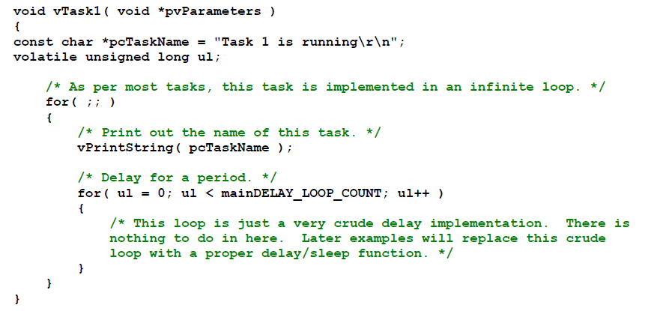
Example trivial task with busy wait (bad)

Slide 18
Task creation
portBASE_TYPE xTaskCreate(
pdTASK_CODE pvTaskCode,
const char * const pcName,
unsigned short usStackDepth,
void *pvParameters,
unsigned portBASE_TYPE uxPriority,
xTaskHandle *pvCreatedTask
);
Create a new task and add it to the list of tasks that are ready to run. xTaskCreate() can only be used to create a task that has unrestricted access to the entire microcontroller memory map. Systems that include MPU support can alternatively create an MPU constrained task using xTaskCreateRestricted().
pvTaskCode: Pointer to the task entry function. Tasks must be implemented to never return (i.e. continuous loop).
pcName: A descriptive name for the task. This is mainly used to facilitate debugging. Max length defined by tskMAX_TASK_NAME_LEN – default is 16.
usStackDepth: The size of the task stack specified as the number of variables the stack can hold - not the number of bytes. For example, if the stack is 16 bits wide and usStackDepth is defined as 100, 200 bytes will be allocated for stack storage.
pvParameters: Pointer that will be used as the parameter for the taskbeing created.
uxPriority: The priority at which the task should run. Systems that include MPU support can optionally create tasks in a privileged (system) mode by setting bit portPRIVILEGE_BIT of the priority parameter. For example, to create a privileged task at priority 2 the uxPriority parameter should be set to ( 2 | portPRIVILEGE_BIT ).
pvCreatedTask: Used to pass back a handle by which the created task can be referenced.
pdPASS: If the task was successfully created and added to a ready list, otherwise an error code defined in the file errors.h
From the task.h file in FreeRTOS

Slide 19
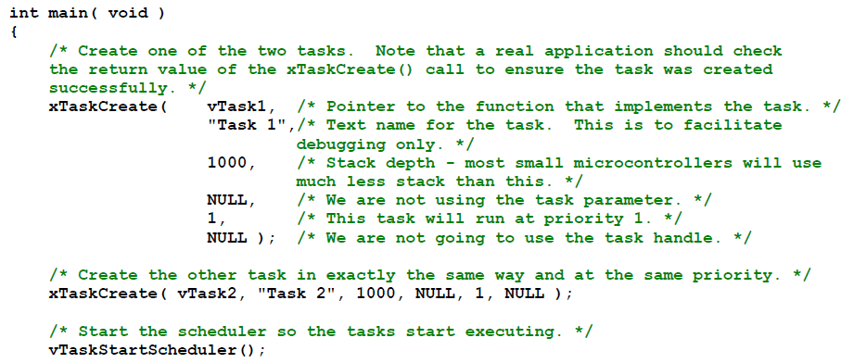
Creating a task: example

Slide 20
OK, I’ve created a task, now what?
Task will run if there are no other tasks of higher priority
And if others the same priority will RR.
But that begs the question: “How do we know if a task wants to do something or not?”
The previous example gave always wanted to run.
Just looping for delay (which we said was bad)
Instead should call vTaskDelay(x)
Delays current task for X “ticks” (remember those?)
There are a few other APIs for delaying…
Now we need an “under the hood” understanding

Slide 21
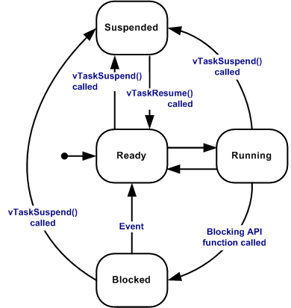
Task status in FreeRTOS
Running
Task is actually executing
Ready
Task is ready to execute but a task of equal or higher priority is Running.
Blocked
Task is waiting for some event.
Time: if a task calls vTaskDelay() it will block until the delay period has expired.
Resource: Tasks can also block waiting for queue and semaphore events.
Suspended
Much like blocked, but not waiting for anything.
Tasks will only enter or exit the suspended state when explicitly commanded to do so through the vTaskSuspend() and xTaskResume() API calls respectively.
Mostly from http://www.freertos.org/RTOS-task-states.html

Slide 22
Tasks: there’s a lot more
Can do all sorts of things
Change priority of a task
Delete a task
Suspend a task (mentioned above)
Get priority of a task.
Example on the right
But we’ll stop here…
void vTaskPrioritySet( xTaskHandle pxTask,
unsigned uxNewPriority );
Set the priority of any task.
pxTask: Handle to the task for which the priority is being set. Passing a NULL handle results in the priority of the calling task being set.
uxNewPriority: The priority to which the task will be set.

Slide 23
Outline
Quick review of real-time systems
Overview of RTOSes
Goals of an RTOS
Features you might want in an RTOS
Learning by example: FreeRTOS
Introduction
Tasks
Interrupts
Internals (briefly)
What’s missing?

Slide 24
Interrupts in FreeRTOS
There is both a lot and a little going on here.
The interface mainly uses whatever the native environment uses to handle interrupts
This can be very port dependent. In Code Composer Studio you’d set it up as follows:
#pragma vector=PORT2_VECTOR
interrupt void prvSelectButtonInterrupt( void )
That would cause the code to run on the PORT2 interrupt.
Need to set that up etc. Very device specific (of course).

Slide 25
More: Deferred Interrupt Processing
The best way to handle complex events triggered by interrupts is to not do the code in the ISR.
Rather create a task that is blocking on a semaphore.
When the interrupt happens, the ISR just sets the semaphore and exits.
Task can now be scheduled like any other. No need to worry about nesting interrupts (and thus interrupt priority).
FreeRTOS does support nested interrupts on some platforms though.
Semaphores implemented as one/zero-entry queue.

Slide 26
Outline
Quick review of real-time systems
Overview of RTOSes
Goals of an RTOS
Features you might want in an RTOS
Learning by example: FreeRTOS
Introduction
Tasks
Interrupts
Internals (briefly)
What’s missing?

Slide 27
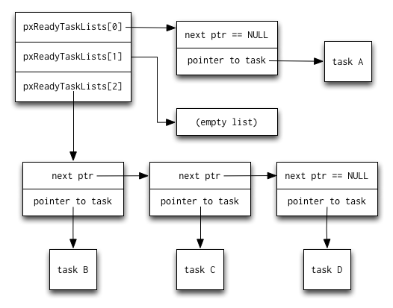
Common data structures
This figure and the next are from http://www.aosabook.org/en/freertos.html

Slide 28
